Slide 1

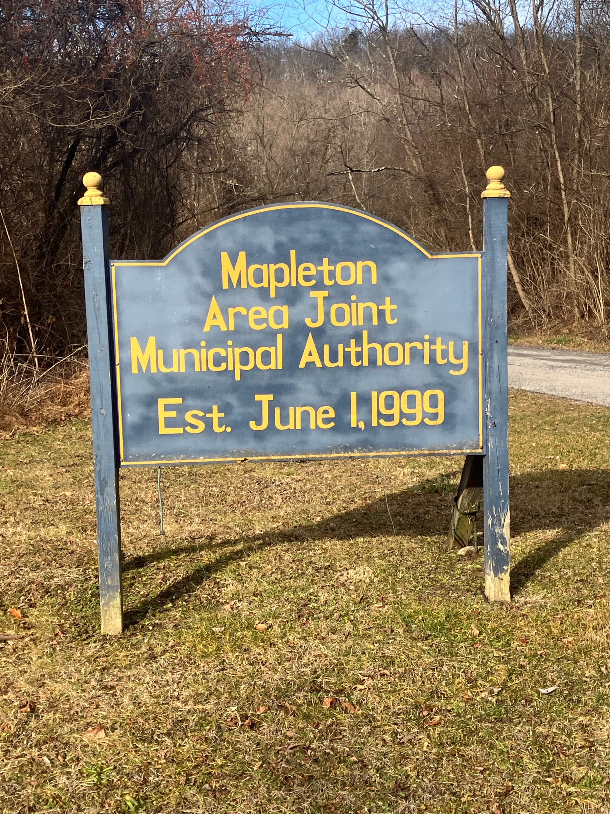

Slide 2
GET TO KNOW YOUR AUTHORITIES
MAPLETON MUNICIPAL AUTHORITY
MAPLETON AREA JOINT MUNICIPAL AUTHORITY
SECRETARY: CORDELIA BEATTY
BOARD MEMBERS:
MICHAEL CORBIN (CHAIRMAN)
JEFF WISE (VICE CHAIRMAN)
DANIEL YOUNG
BRUCE RICHARDS
HERB SKIPPER
SECRETARY: CORDELIA BEATTY
BOARD MEMBERS:
MICHAEL CORBIN (CHAIRMAN)
PAM WISE (VICE CHAIRMAN)
BRUCE RICHARDS
HERB SKIPPER

Slide 3
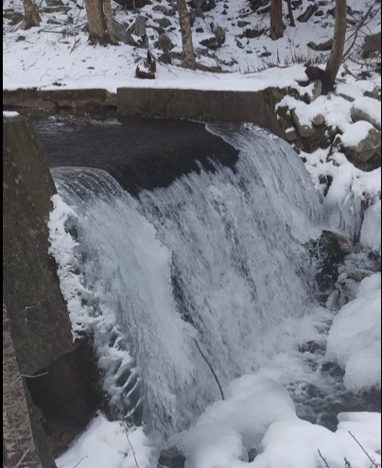
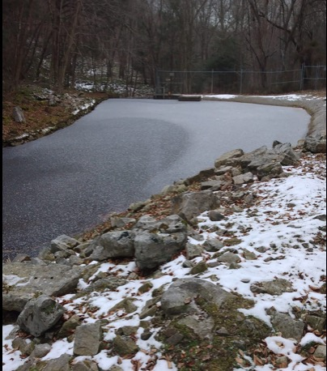
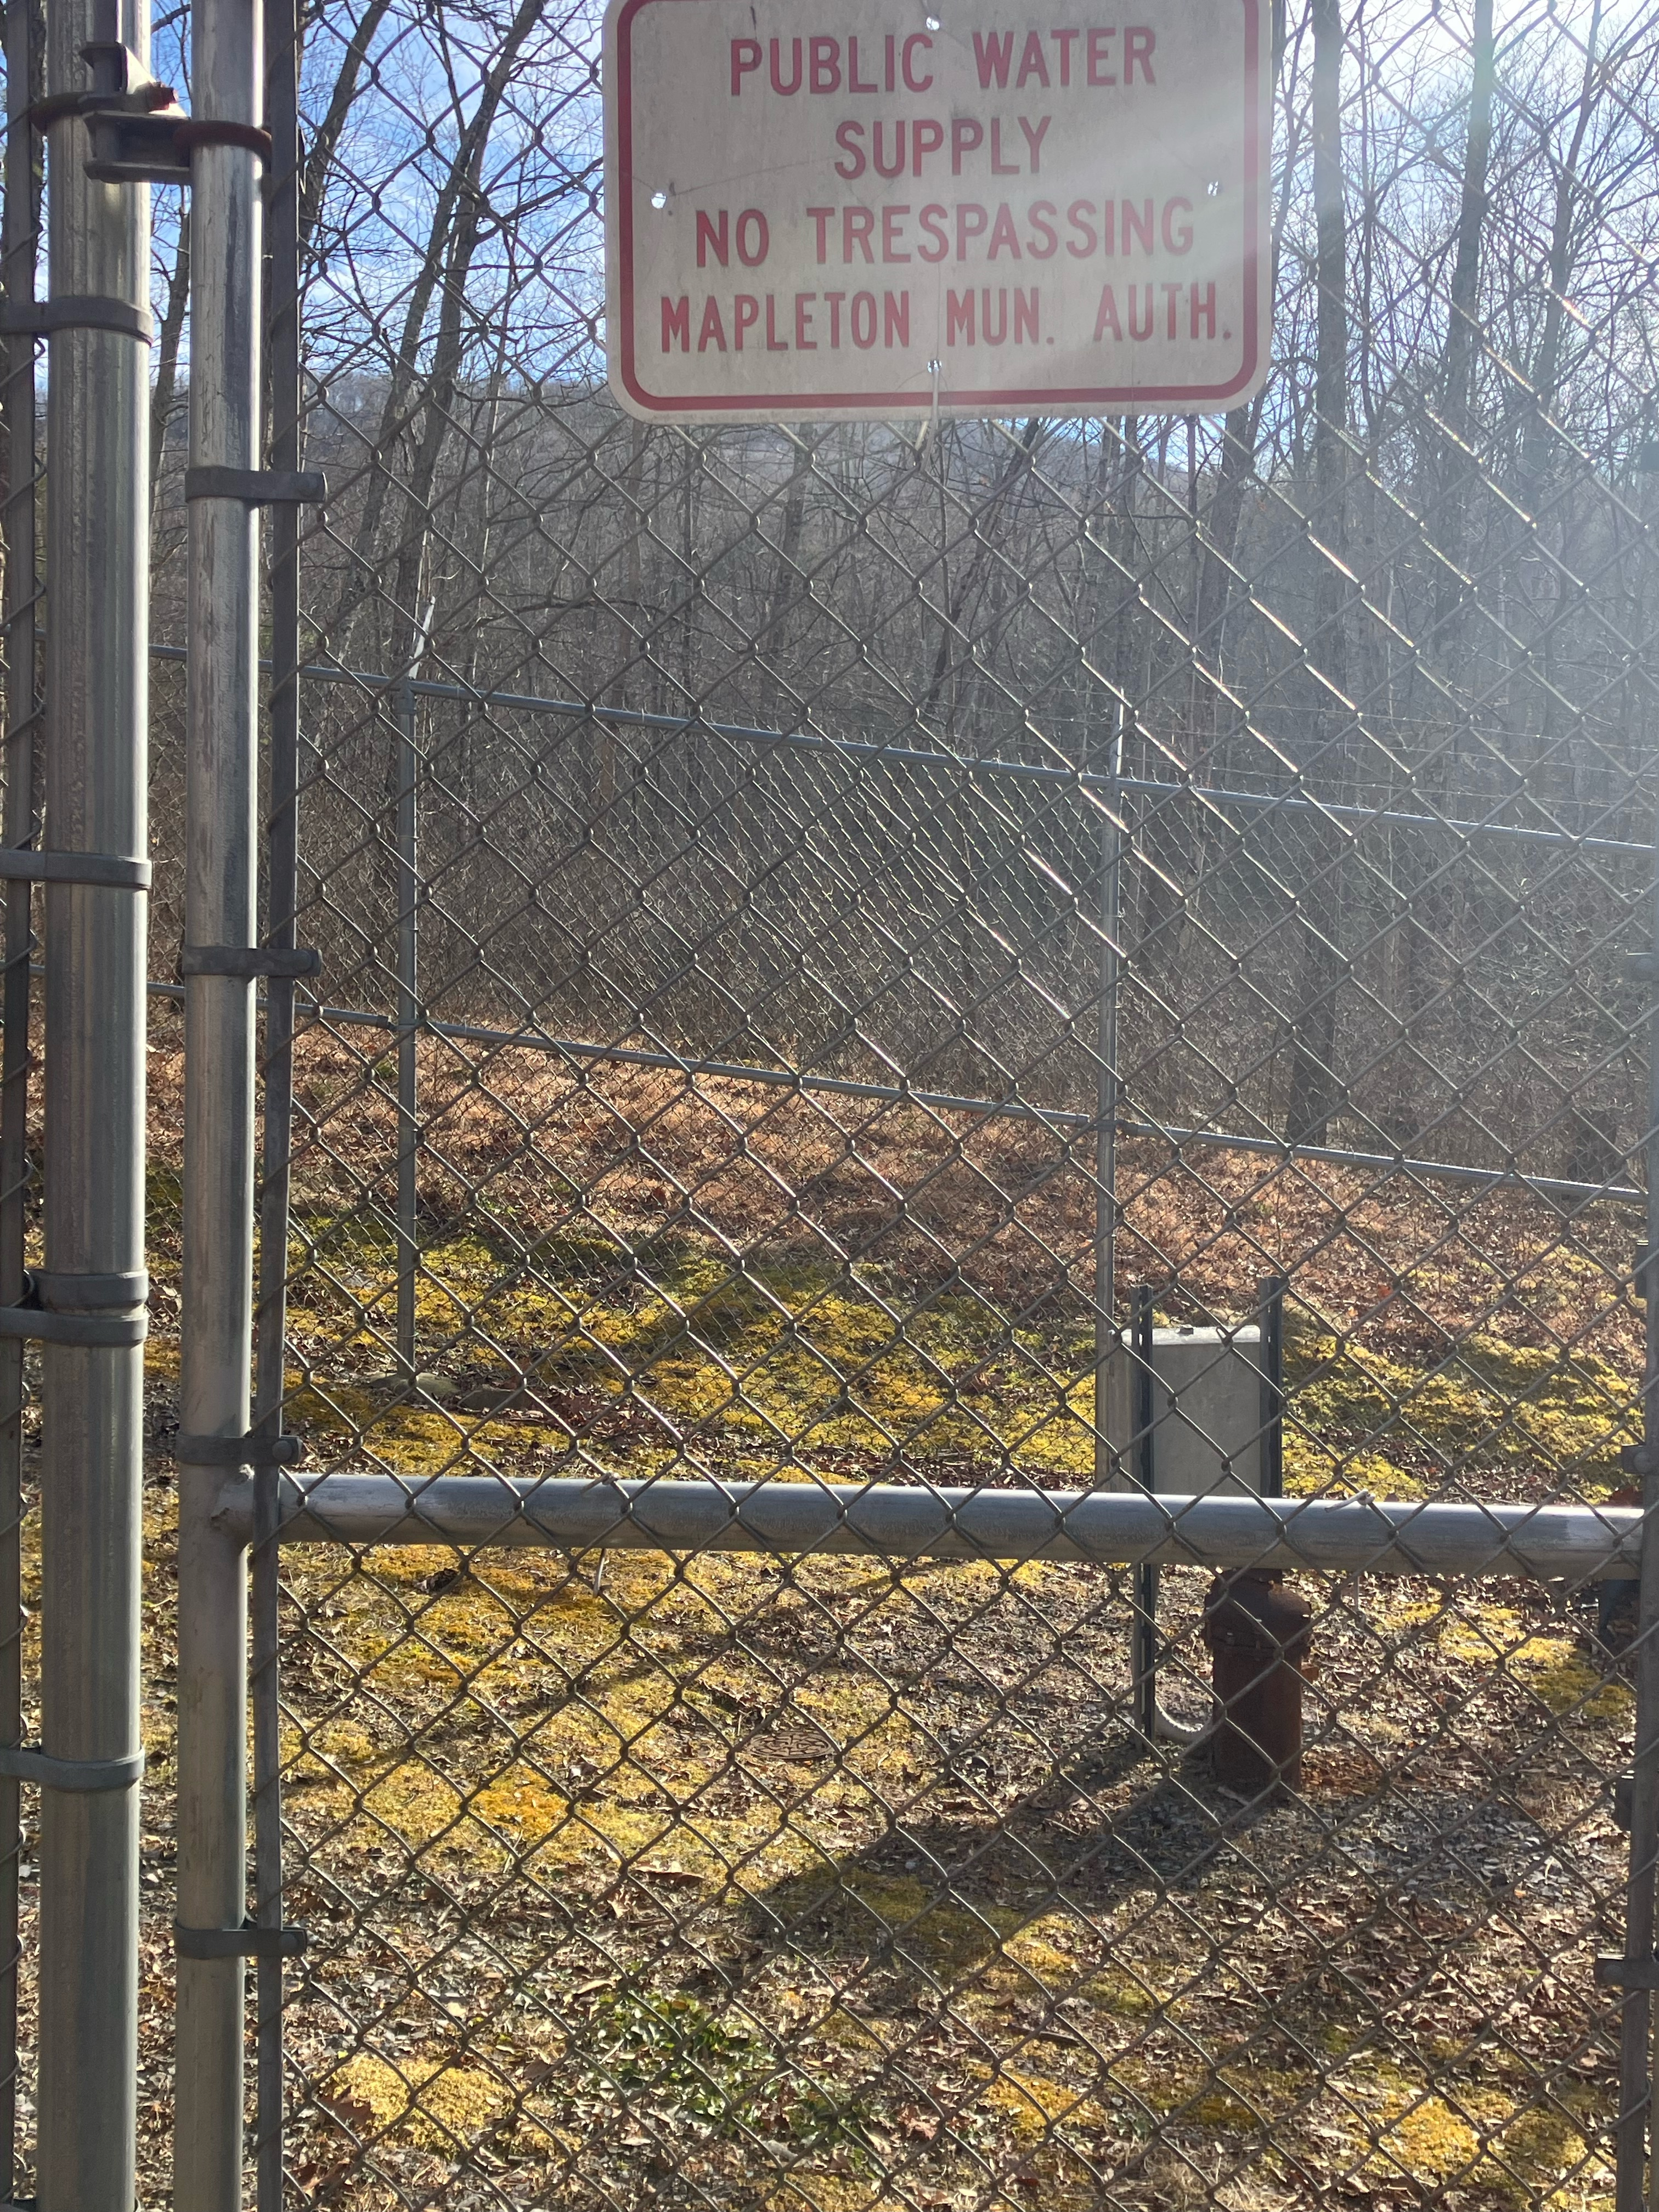
WATER SOURCES
SPILL WAY AT DAM
RESERVOIR
WELL

Slide 4
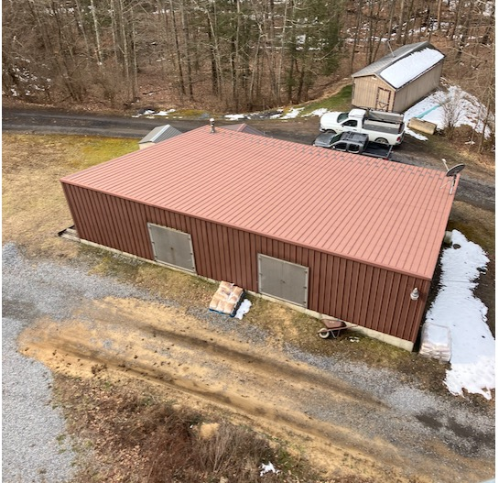
WATER PLANT
OPERATORS:
TOM CRAMER
CORDELIA BEATTY
HUNTER CORBIN
TRAVIS LONG (CONTRACTED)
YEARLY USAGE 7.2 MILLION

Slide 5
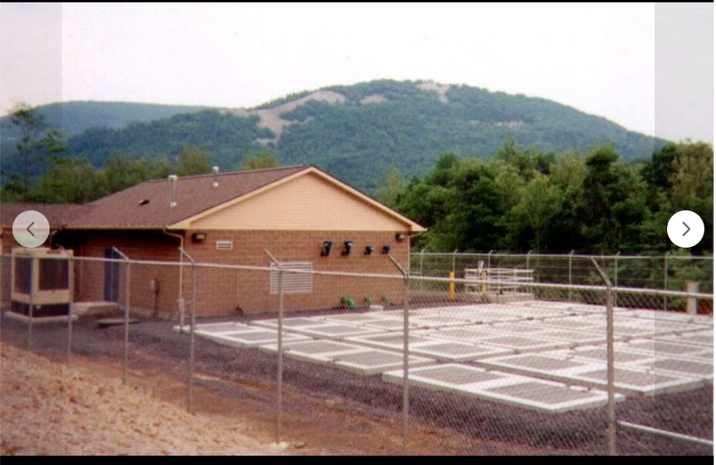
SEWAGE PLANT
OPERATOR:
JASPER HANKEY (CONTRACTED)
KEVIN McCONAUGHEY

Slide 6
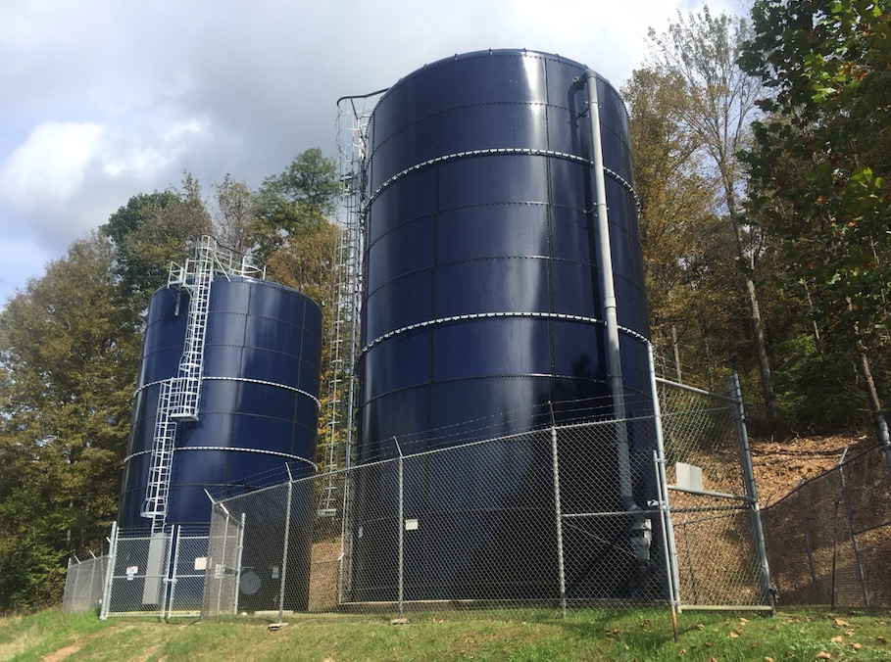
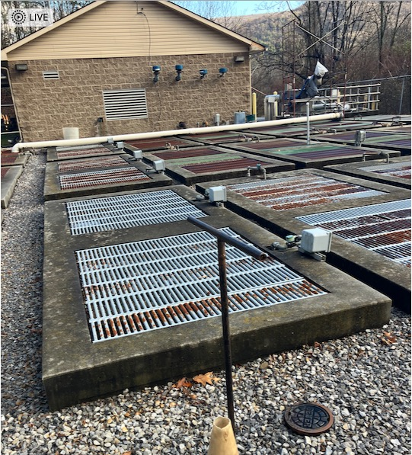
PLANTS CONTINUED
MAPLETON MUNICIPAL AUTHORITY
MAPLETON AREA JOINT MUNICIPAL AUTHORITY

Slide 7
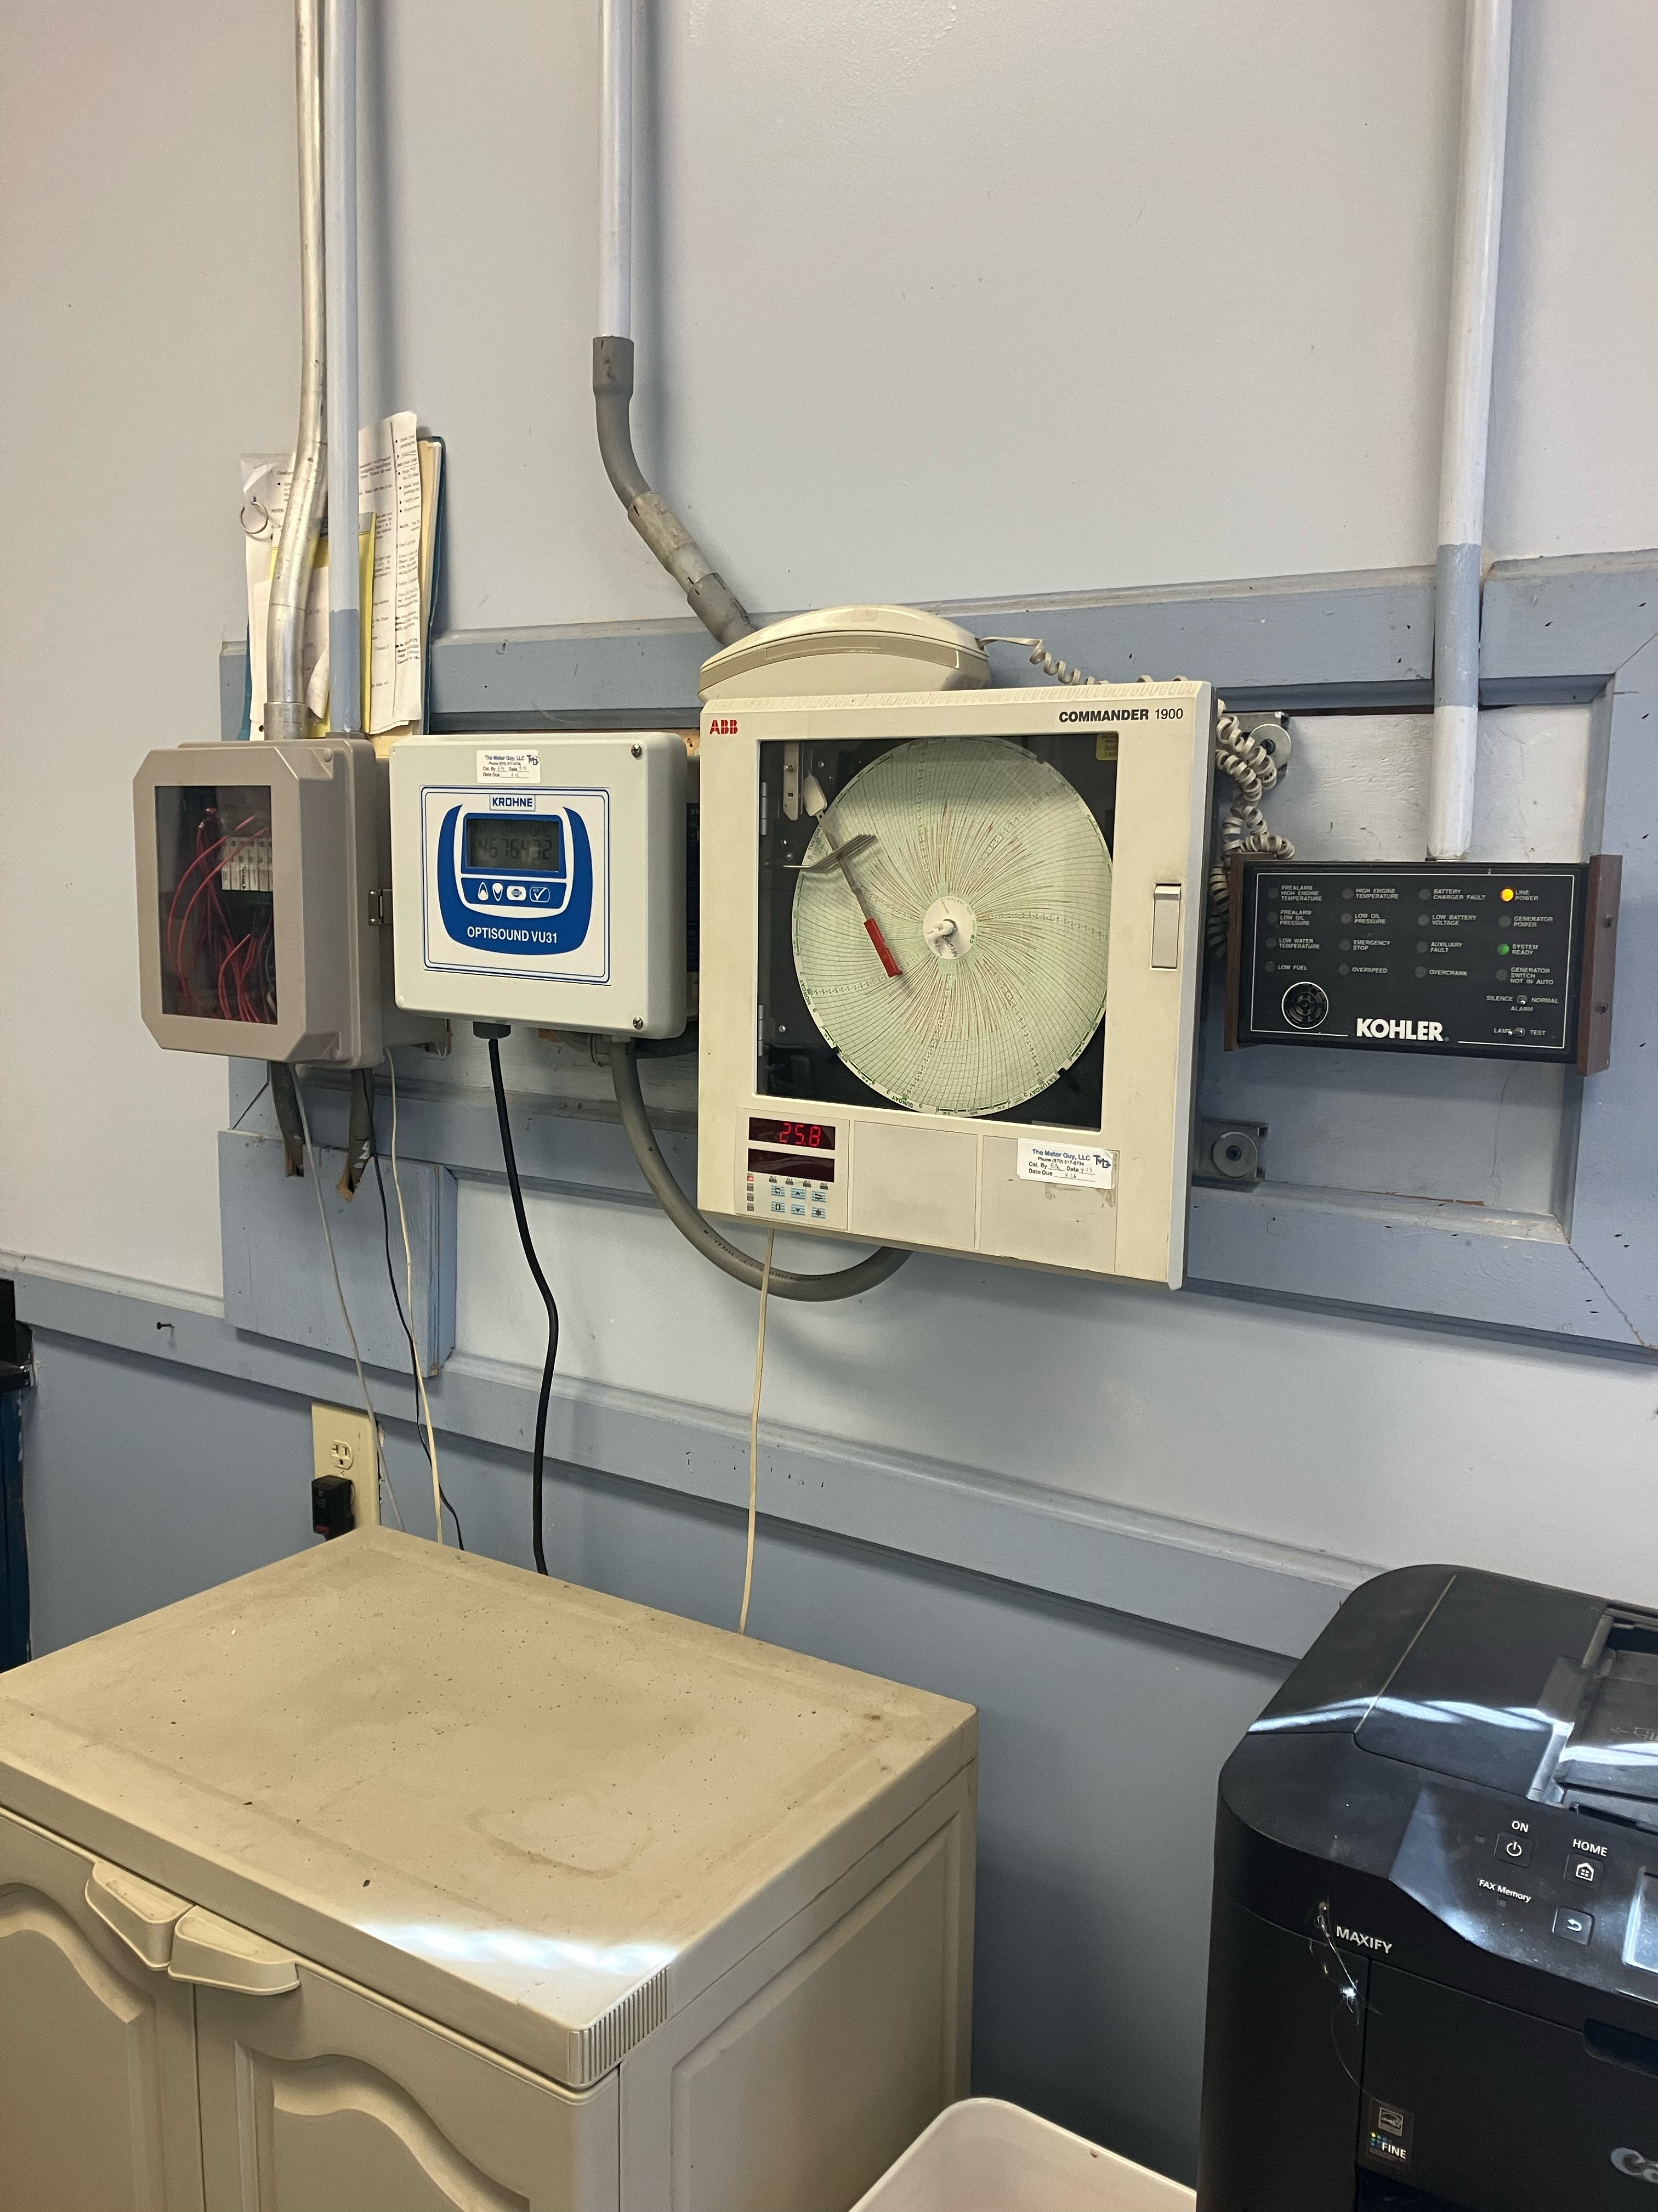
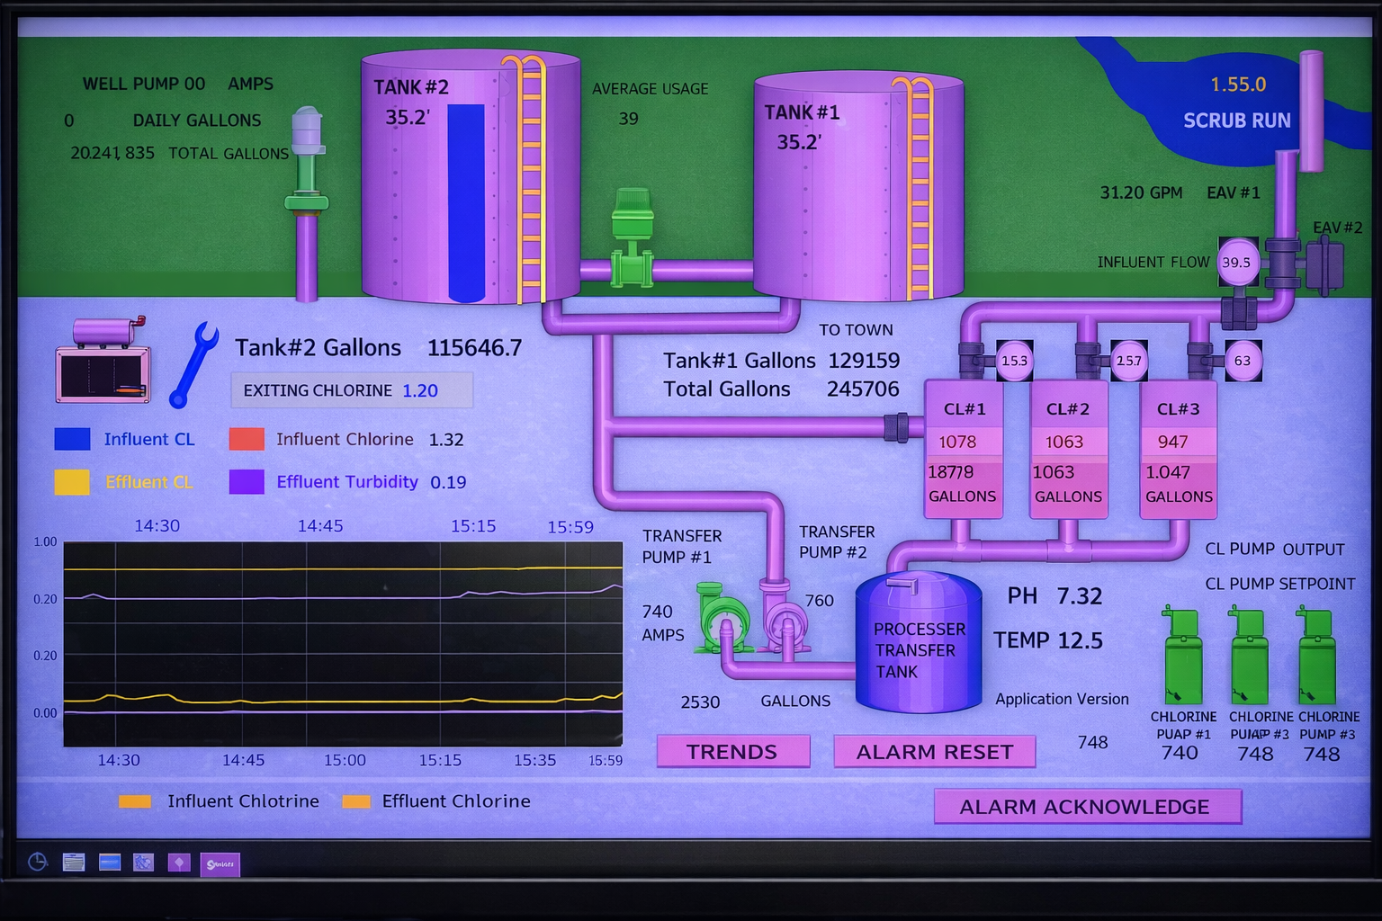
OPERATIONS
MAPLETON MUNICIPAL AUTHORITY
MAPLETON AREA JOINT MUNICIPAL AUTHORITY

Slide 8
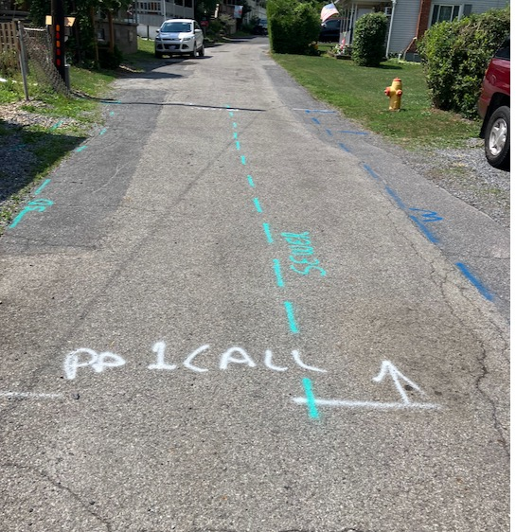
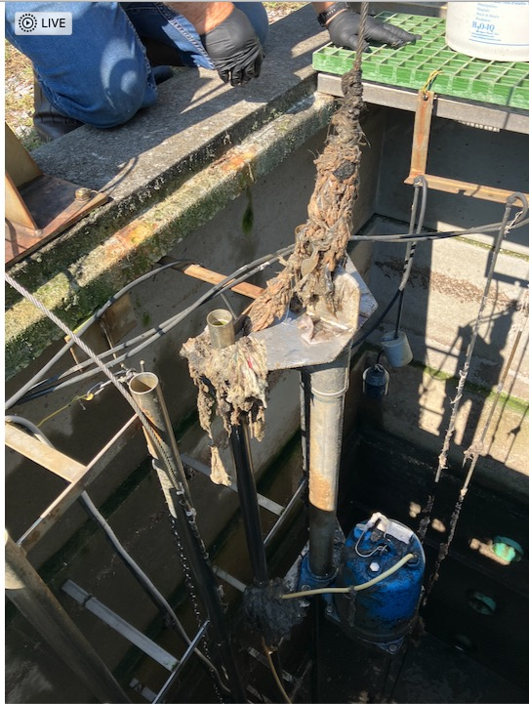

Slide 9
FINANCES
MAPLETON MUNICIPAL AUTHORITY
MAPLETON AREA JOINT MUNICIPAL
2025 YEARLY TOTALS
CREDITS : $117,246.71
DEBITS : $89,573.25
2025 YEARLY TOTALS
CREDITS : $184,238.80
DEBITS : $168,705.18

Slide 10
CHECKS & MAILING ADDRESS
2 SEPARATE CHECKS, 1 ENVELOPE
MAPLETON MUNICIPAL AUTHORITY
P.O. BOX 306
MAPLETON DEPOT, PA 17052
*TOP SLOT IN BOROUGH BUILDING*
MAPLETON AREA JOINT MUNICIPAL AUTHORITY
P.O. BOX 306
MAPLETON DEPOT, PA 17052
*TOP SLOT IN BOROUGH BUILDING*

Slide 11
CONTACT INFORMATION
https://www.mapleton-pa.com/water
https://www.mapleton-pa.com/sewage
MAPLETON MUNICIPAL AUTHORITY
MAPLETON AREA JOINT MUNICIPAL AUTHORITY
EMAIL:
water@mapleton-pa.com
CELL PHONE:
814-542-3293
EMAIL:
sewage@mapleton-pa.com
CELL PHONE:
814-542-3293

